Slide 1
Impersonation and More:
Enhancements in the Current Blue Update
Margot MacNutt, Training Manager

Slide 2
Project Interface & Management Changes
Reporting Enhancements
Spreadsheets: Enhanced structure & review of configuration options

Slide 3
Project Interface & Management Changes
Internal Project Title
New Due Date variable for use in Task emails: $TASK_ENDDATE
Question Bank enhancements
Response Rate Monitor controls for Project Managers
Impersonation feature

Slide 4
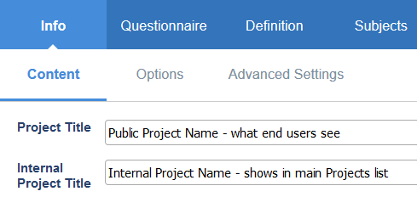
Internal Project Title
Optional alternate title for internal use and search capabilities
Seen only by Project owners
If used, displayed in the Projects list, Management screens, Create Report list and when searching project names
Main Project Title is displayed publicly for Fill Out, QP and SVM tasks, and reports; it’s also what Admins see in BPI

Slide 5
New Due Date Variable for Task Messages
$TASK_ENDDATE shows earliest task due date in emails, works with all task types (Fill Out, QP, SVM, etc.)
Displays earliest due date for all tasks of the same type within a project
E.G., multiple courses to evaluate with different due dates, it displays the earliest due date only
Can be used in the Subject line in addition to the email body, for invitation, reminder and manual reminder emails
Supported in all project types: surveys, 360s, all subject and subject pairing options
Format is the same as $TASK_LIST_ACTIVE, and adjusts automatically to fit the language settings, e.g. “Lundi 9 février, 2019”

Slide 6
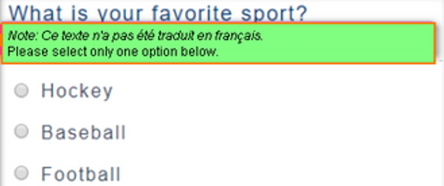
Question Bank Enhancements
Comments can now be enabled in Question Bank Single Selection Placeholder blocks; results can be included in Frequency and Score blocks in reports
Multilingual questionnaires where translations are missing for certain questions, the system will automatically display a warning about the missing translation in the base language of the form
Warning text can be customized in XML, and text formatting can be controlled in Question Details area

Slide 7
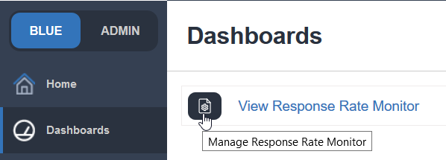
Response Rate Monitor controls for Project Managers
Project Manager type Admin accounts now have access to controls to add / remove own projects for monitoring
Includes any projects they create or have shared access to, and projects that use datasources to which they have the data source access key
Some limitations: the following sections are not configurable by PM
Settings
Milestones and Targets
Subject Details
Not available for Project Manager Assistants

Slide 8
Impersonation Feature
Allows Admins, Project Managers and Project Manager Assistants to “Log in as” a select user to see their dashboard view of assigned tasks and/or reports
Must ask Support to enable feature for you: request it when scheduling your upgrade
Once enabled, you must log into Blue using the blueadmin system account to set the impersonation privilege for the selected Project Administrator(s) by editing their account in Record Mgmt

Slide 9
Impersonation Feature - Logging
New logging details show which account has been impersonated and by whom
The User ID displays the ID of the person whose account is being impersonated, and the administrator who accessed the account is displayed in the Impersonator ID column

Slide 10
Reporting Enhancements
Export report changes
Distributable CSV raw data reports in Group By reports
Using Virtual Questions and Cross Category blocks with Question Bank placeholders
Enhanced report search on Home page
Response threshold controls at the Question Block level

Slide 11
New Export Report Options
Administrative Status tracks individual task status settings in the export report, when required
Based on manual changes and/or automated settings selected in Tasks > Task Options > Impact of Owner Removal
Added rater demographic info for all statuses: any selected rater demographic details are displayed for each student, no matter the task status at the time the export report is created
We also keep track of any students (raters) who have not completed the surveys

Slide 12
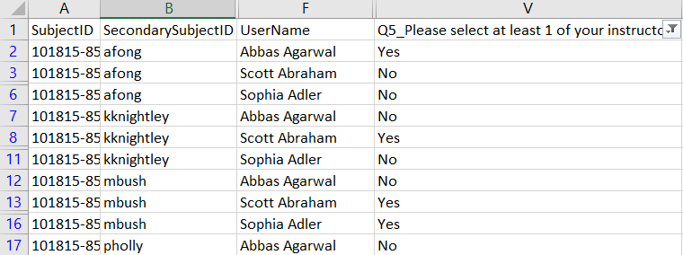
New Export Report Options
Added instructor selection results based on Secondary Subject Selection settings
Yes / No flags indicate which instructor the student selected

Slide 13
CSV distributable reports available with Group By reports
Available when grouping by Primary or Secondary subject data only
Not available for use with Rater demographic data (e.g. students or users with Fill Out rights)

Slide 14
Enhanced report block support for Question Bank placeholders
Virtual Questions & Cross Category report blocks are now supported in individual and group by (aggregate) reports
In aggregate reports, placeholders can be used when all courses within all selected groups share a common hierarchical question mapping and structure, and the mappings are unique for each question
Potential exceptions with aggregate reports
Some placeholders might not be accessible if mapping not unique per question, e.g., using switch forms, using merged/cross-listed courses with different question mappings, certain hierarchical type question markers don’t apply for all items in the report grouping
The behavior within the report block will adjust according to the items selected in the Groups list: you must select the groups to report on first, and then the available question list changes automatically
If any QBank items aren’t usable for particular groups, they can’t be selected within the report block

Slide 15
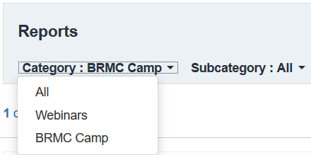
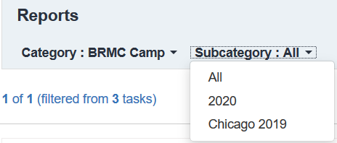
Enhanced report search controls on Home page
Added to the Home page
Pre-populates all Category & Subcategory names configured by the Project Administrator
Views are visible to anyone with Report Viewing rights and/or when impersonating someone with RV rights

Slide 16
Block Level Response Threshold Settings
Applicable to standard question-type report blocks and Question Bank placeholders
Admin must set the threshold number and create a custom message if needed – no default message text supplied
Message can be customized using the HTML edit controls

Slide 17
Block Level Response Threshold Settings: Resulting Behavior
Applies to frequency, score, comment, and spreadsheet blocks, but not scale distribution
Only the questions that meet the response minimum will be shown, even when using tables and dual-scale questions
If the minimum is not met, the question(s) will not be shown on the report at all unless an explanation message is supplied
If using thresholds at both the report and block levels, the block level is implemented last

Slide 18
Review of Spreadsheet functions with cascaded breakdowns in aggregate reports
Different behavior when adding the comparative norms to the table vs. using the Group Elements
Using the Breakdown Section to provide 2nd level breakdowns

Slide 19
Q & A Thank you!

Slide 20
See you in Chicago for Bluenotes Global 2020!

