Slide 1
Managing Large Questionnaires with Blue
Cascaded versus Conditional
Presenter: Alexandra Rascanu

Slide 2
Agenda
Large Questionnaires
Questionnaire Logic
Triggers
Question Bank
Conclusions

Slide 3
Large Questionnaires
Great number of questions
Great number of forms (combinations of questions)
Complex questionnaire logic

Slide 4
Questionnaire logic: Cascaded versus Conditional

Slide 5
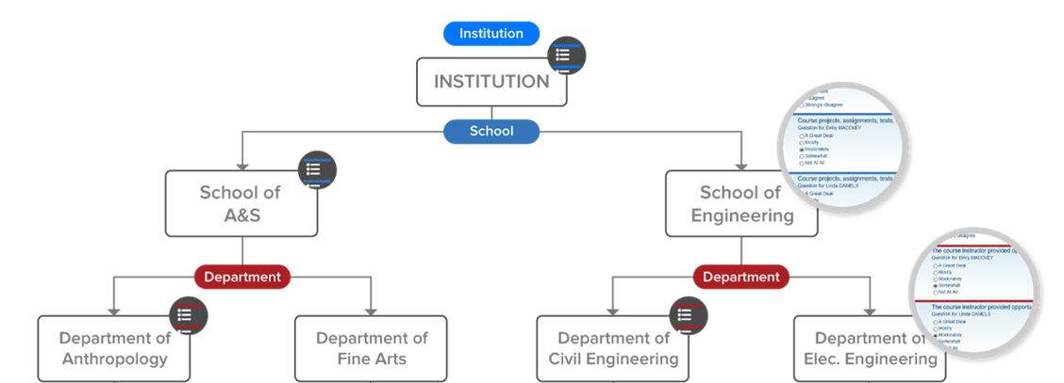
Questionnaire logic: Cascaded
5 questions
6 questions
7 questions
5 questions
8 questions
3 questions
4 questions

Slide 6
Questionnaire logic: Conditional
Instruction mode = in class
Department = Chemistry
Course # > 100 and <300
Instrument = 15 questions
Primary instructor -> 6 questions
Teaching assistant -> 3 questions
Online course -> 8 questions
In-class course -> 5 questions
Class is a requirement for student -> 4 questions
Class is an optional for student -> 2 questions

Slide 7
Triggers

Slide 8
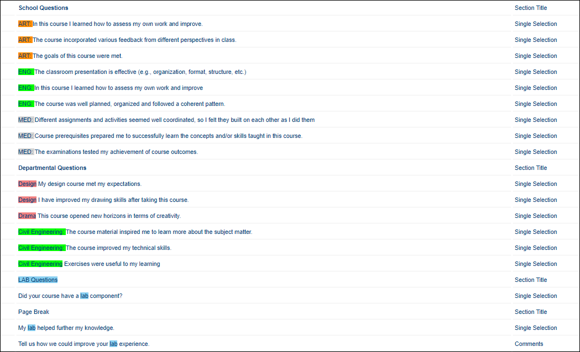
Triggers: Questionnaire
School questions
Departmental questions
LAB questions

Slide 9
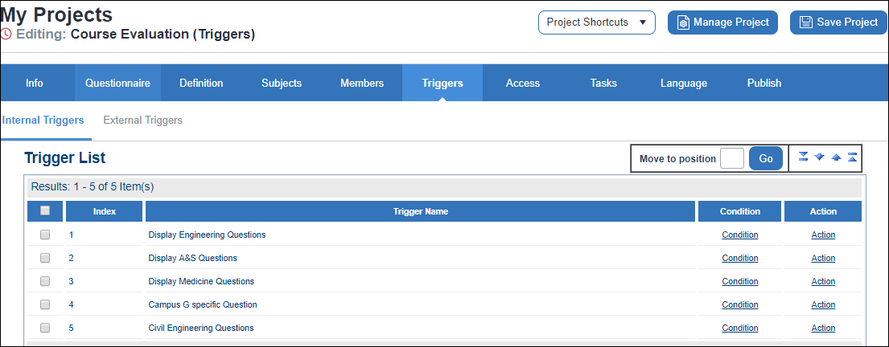
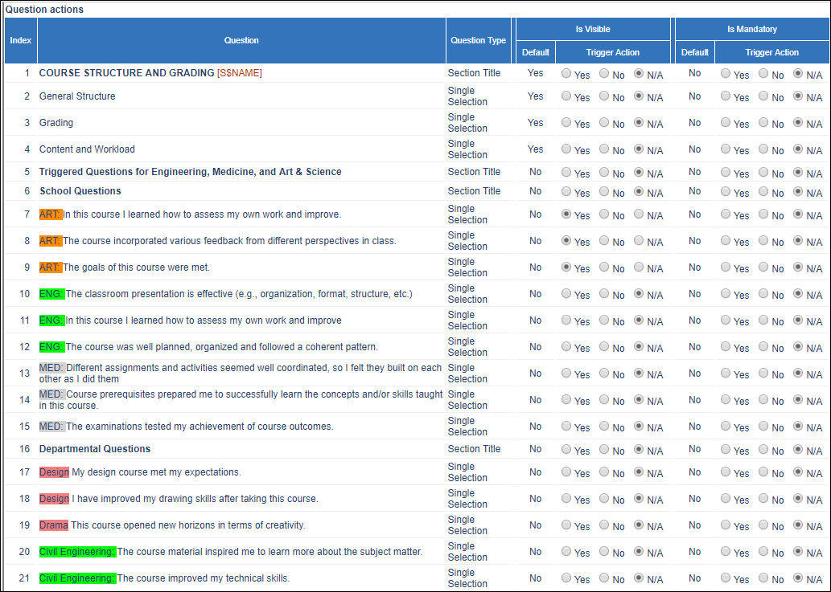
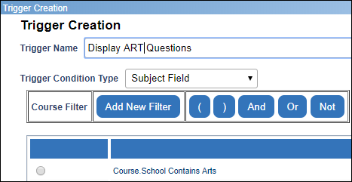
Triggers: Condition and Action

Slide 10
Question Bank

Slide 11
Question Bank Overview
Your Question Bank List:
Create and upload the list of questions to be used (Repository)
Project and placeholders:
Create the project and add placeholders for the question bank items
QBank mapping:
Configure the QBank mapping between the question bank and the question placeholders
QBank and reporting
Design and generate comparative, frequency, scale distribution, open ended analysis (and more…)

Slide 12
Why we built QBank
Large-scale data collection
i.e. the ability to include all type of stakeholders in the course evaluation process, with the added benefit of targeted questions for each type of stakeholder.
The tendency of adding more and more questions to the course evaluation instrument, as each academic unit design their questions, while a central unit handles the entire course evaluation process
The need to unify the feedback collection in a cascaded way, i.e. while having targeted questions at every level of the institution hierarchy.
Notes:
In Blue 7, Question bank, combined with relationship demographics and teaching role support form the foundation of Large-scale data collection i.e. to be able to include all type of stakeholders in the course evaluation process with the capability of targeted questions for each type of the stakeholders. The following are the specific uses cased why we built Qbank.

Slide 13
Why we built QBank
An excellent way to manage large set(s) of questions across projects, for example, be able to refine question captions for all project at once (Question bank management / privileges, version control, multilingual etc.)
Better potential to benchmark/compare results, as each question is unique in the repository and has a unique identifier.
Report creation efficiency – fewer report blocks required

Slide 14
Question Bank: Create your Qbank list
May contain unit code or form switch
Designed by Blue admin for internal reference, not visible to students or teachers
Displays for students
Question subtitle
Displays for report viewers

Slide 15
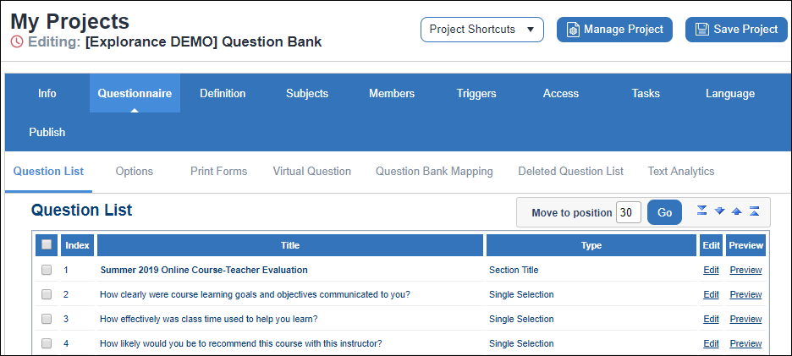
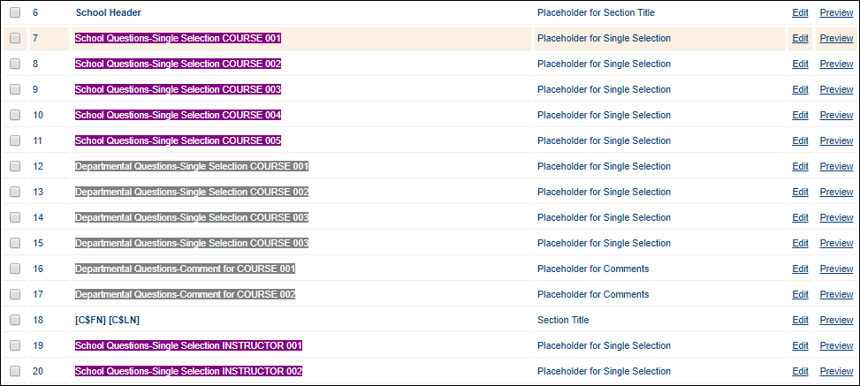
Question Bank: Project and placeholders
QBank placeholders (school, departmental etc.)
Institution-wide questions
(regular questions)

Slide 16
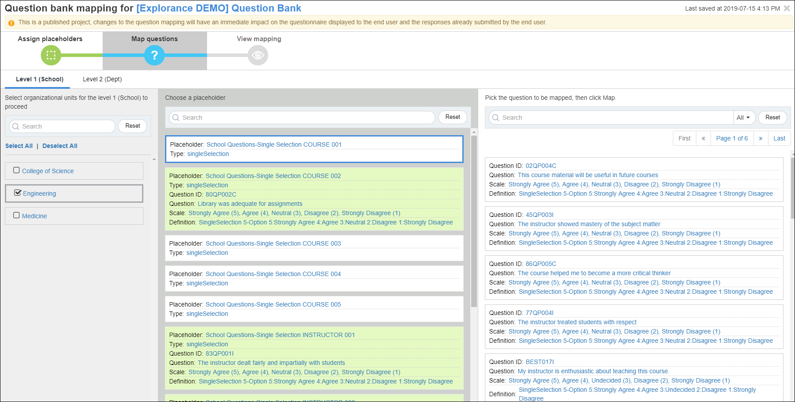
Question Bank: Mapping
Mapping questions for Engineering School
Choosing the placeholder on which to map additional question
Mapping additional questions
Questions already mapped

Slide 17
Question Bank Conditional

Slide 18
Question Bank - Form Switch
In Blue, the term Form Switch is used to describe a flag, a course value existing in the institution’s data; this form switch represents a unique group of conditions.
Form switches are used for question assignment, typically when the institution’s question assignment logic is not cascaded, but rather conditional, and a Question Bank implementation is required, in order to accommodate a great number of questions.

Slide 19
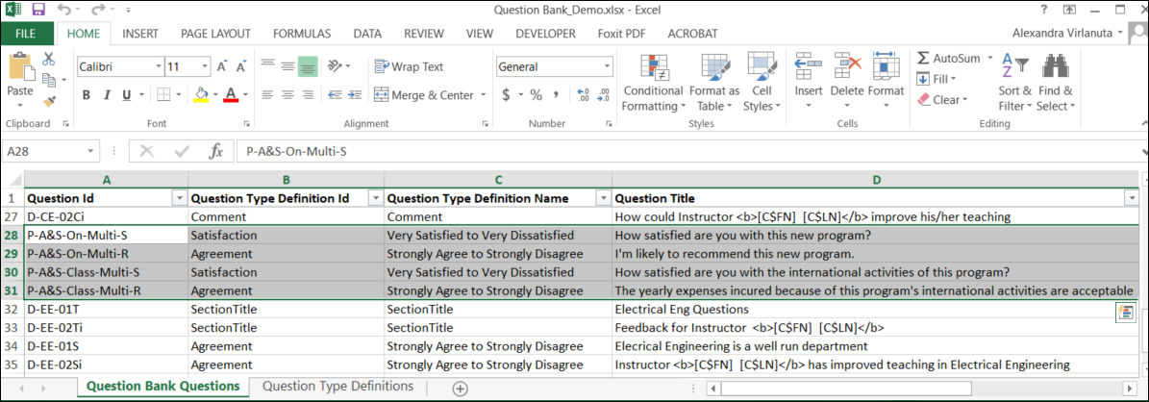
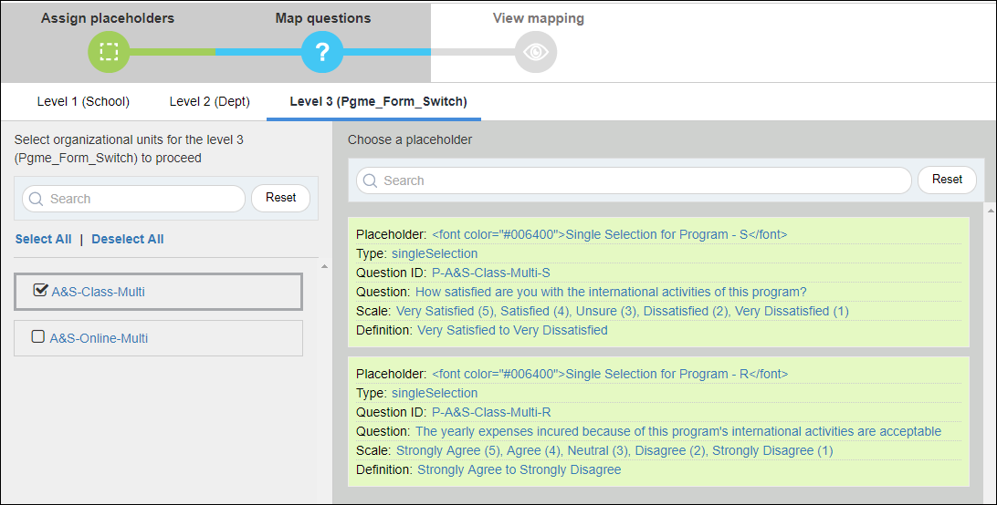
QBank list and Placeholders
Questions specific to a series of conditions, instead of a specific unit.
Levels 1 and 2 are cascaded / hierarchical, while level 3 is a form switch

Slide 20
Conclusions

Slide 21
Conclusions
Triggers: Cascaded or conditional questionnaire logic, questions are assigned on one or multiple criteria, whether the condition is the response to a previous question or a course, instructor or student demographics.
Pros: Trend reporting, ideal for branching needs
Cons: Cumbersome to maintain with complex questionnaire logic
QBank : Cascaded (Hierarchical) or conditional (Switch forms) logic, complex questionnaire logic, great number of forms, questions or both, multiple report blocks per question required.
Pros: Favors automation, easy to set up (friendly interface), easy to maintain.
Cons: Trend reporting possible on core questions only (coming soon).
Hybrid: Question Bank and triggers can be used together in the same project, to meet all the requirements of a more complex feedback gathering process.

Slide 22
Questions?

