Slide 1
Automating End-to-End
Feedback Processes in Blue
Presenter: Fernando Sanchez, Senior Consultant

Slide 2
Introduction
Use Cases
Blue: Feedback Process Implementation
System configuration, project and report setup
General recommendations

Slide 3
Introduction

Slide 4
Expectations
What we would like you to take away from this session:
Drivers for automating a higher education course evaluation: use case.
Some differences for automating a corporate learning evaluation
What to consider to take advantage of Blue automation capabilities?

Slide 5
Key Concepts
Feedback in context of survey application types
Student Journey Analytics
Course/module/program Evaluations
Employee Journey Analytics
Corporate Learning Evaluations
Automation
Blue integration capabilities
Settings for making your Blue Admin life “easier”

Slide 6
Use Cases

Slide 7
University Course Evaluations
We need to engage Students and provide a seamless/transparent experience to end users.

Slide 8
Corporate Learning Evaluations
We require full integration with our Corporate Portal.

Slide 9
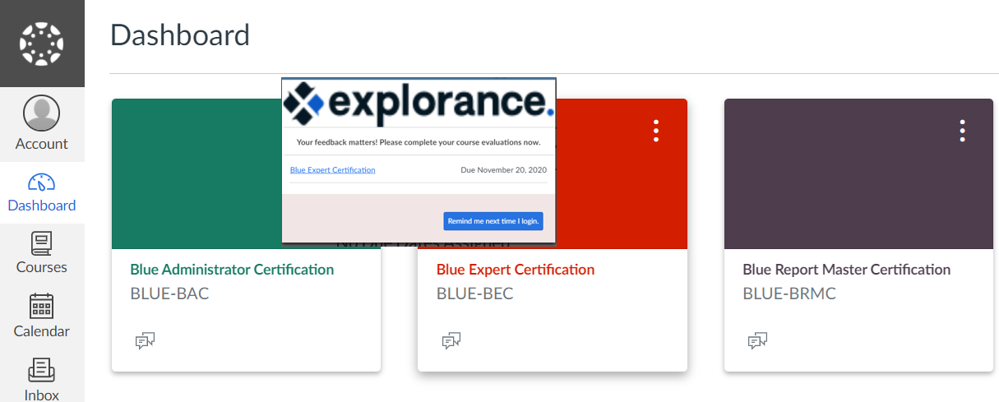
Approximately 72% of Explorance Customers have a commercial Student Portal.

Slide 10
Blue: Feedback Process Implementation

Slide 11
Feedback Process Implementation
Requirements Gathering
Data feed automation opportunities
Business rules for Projects & Reports
User Experience
Email access considerations
Exporting row data
External factors
Planning & Resource Allocation
IT resources
Closing
Configuration & Testing
Schedule automatic data feeds
Project automatic updates settings
survey deployment criteria
Report automatic generation and distribution
LMS integration
Row data extracts
Formal UAT & Rollout
Legend
Reporting
Project Sponsor/Manager
Certified Blue Admin
IT
Monitoring & Support

Slide 12
System configuration, project and report setup

Slide 13
Blue Configurations
Data
Data Sync Tool
Blue “Cloud Connectors”
Other
Data import alerts
Integrations
Data
SSO
LMS
Emails
Most popular SIS among Explorance Customers: Banner 21% followed by PeopleSoft 13%.

Slide 14
Project Setup
Project ‘Automatic update’
Group ‘Automatic update’
Subject & Group Filters
Impact of Owner Removal
Task options
Enable Automatic Sync & “Update dates for open tasks based on current task settings”

Slide 15
Reports Setup
Filters
Distribution dates (Subject End Date or demographic Date Field)
Impact of Owner Removal
Responses threshold

Slide 16
Sync Times (typical)
Course Evaluations Data Flow | Sync Time
Blue - auto update (projects and reports) | Daily @ 2:00 AM
BPI synch | Daily @ 3:00 AM
Form Fillout Tasks activate | Daily @ 8:55 AM
Pathways synch | Daily @ 9:00 AM
Connector synch | Daily @ 10:00 AM

Slide 17
Things change …
External factors could disrupt the status quo
Courses get cancelled
Students withdraw courses because they cannot travel for onsite classes
Institutions adjust courses delivery method
Courses get re-scheduled
Students may decide to pursue a different path

Slide 18
System configuration, project and report setup
General Recommendations

Slide 19
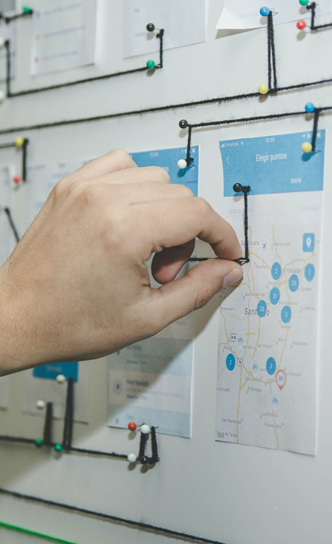
Top 10 considerations
Data feeds (integration and scheduling)
Blue wake-up time
Business rules and use of filters
Tasks status if changes in the enrollment or Subjects
Data updates at the Blue project level
Data updates at the Report level
Potential impacts to Reporting
LMS integration (BPI or deep integration)
Sync times for Blue Integration items
Email integration and communication strategy

Slide 20
Questions?

Slide 21
Thank you!

Slide 22
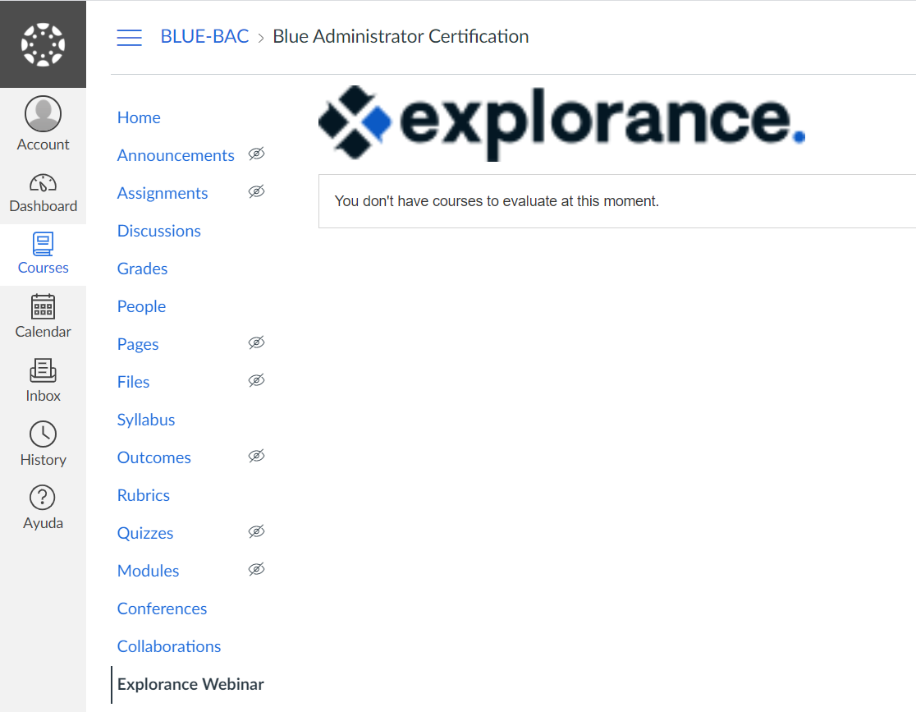

Slide 23
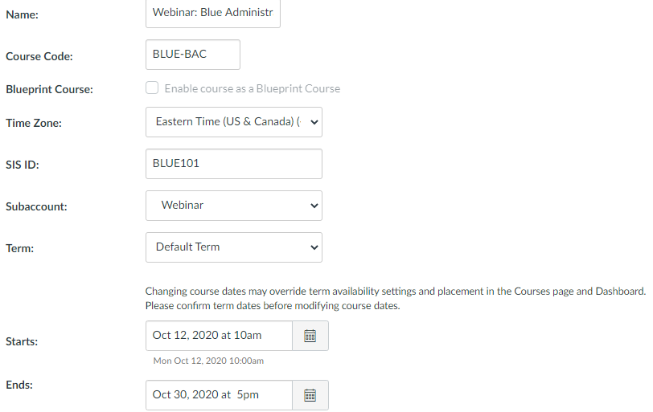
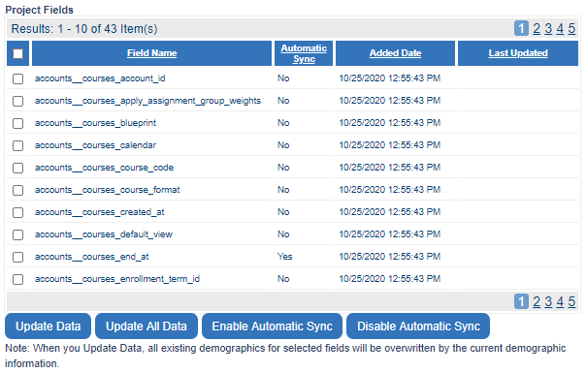

Slide 24
