Slide 1
Summary Steps:
Run an Executive Summary Report, making sure to utilize a relevant benchmark.
Analyze the Executive Summary Report
Were the business results achieved aligned with expectations and course/program objectives?
How have your Key Metrics performed relative to the benchmark and your goals?
Have your reporting portfolios met expectations for performance? Is there an alignment between your Portfolios and the achieved business results?
What questions do you still have? What questions do you think your stakeholders will have?
What sections of the Executive Summary report do you want to include in your final presentation? Examples are included in this template.
Review the recommendations at the bottom of the Executive Summary Report as a starting point to determine successes and opportunities and where to focus your in-depth analysis
Obtain other key data, such as
Report Card Key Metrics
Dashboards
Scrap Learning
Net Promoter data
Learner Comments: where appropriate, add learner comments to support your analysis and recommendations
Utilize Data Explorer and/or run more detailed reports (e.g. Quick Question Report) to identify drivers of positive performance and root causes of performance gaps.
What is the story you want to tell with your learning programs’ data?
Make sure to cover the What, So What, and Now What? within your story.
What recommendations are you making based on your learning programs’ data?
What action steps will ensure success?
Reference the Best Practice Guide: Using Outcome KPIs as Leading Indicators of Business Impact in preparation for delivering this presentation

Slide 2
MTM Stakeholder Presentation
Examples and Guidance

Slide 3
Executive Overview
Successes
Opportunities
Next Steps
Recommended structure for your stakeholder presentation.

Slide 4
Executive Overview
Short initial section that provides a summary of performance, successes and opportunities. Your goal is to get everyone focused on the right things from the beginning.

Slide 5
Q1 2018 Learning Programs Summary
Successes
NPS above benchmark
Operational Efficiency and Mitigate Risk Portfolios are achieving intended Business Results
Courseware scores at/above benchmark
Opportunities
Increase Performance Improvement
Increase Manager Support on the job
Improve on the job application for some strategic courses
Monitor/Improve Instructor performance
Provide a synopsis of your successes and opportunities, based on your summary data and detailed/root cause analysis.
The areas of opportunity are a call to action to improve or change something, based on what your findings while putting the summary together

Slide 6
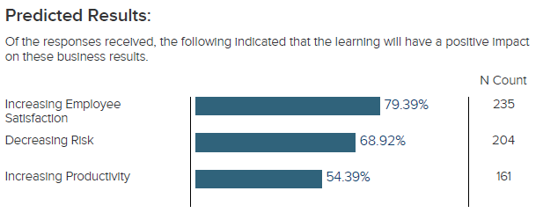
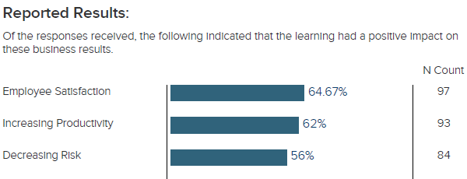
Executive Summary
Data for the donut charts mostly comes from the Report Card
Option 1: Infographic summary
Business Results and BCR from the Exec Summary Report
*77% Bench
*68% Bench
*43% Bench
InnovateU
*77% Bench
Reported BCR: 4.02*
*Benefit to Cost Ratio: for every dollar spent, ~4 dollars were returned in benefit
*38% Bench
Outcomes
*Benchmark = Corporate Universities (All)
Effectiveness
*13% Bench
Notes:
Update the shading on the donut charts by right clicking and updating with your own metrics
Your Executive Overview should be focused on the metrics that are most relevant to your business leaders: What business results were achieved as a result of our training (business results from Exec Summary report); Was the investment made in these programs worthwhile (ROI), Would learners recommend this training (NPS), Did on-the-job performance improve as a result of this training (PI), etc.
The Report Overviews and Report Job Aids can provide you with additional explanation of these various metrics and language to use while presenting to your business leaders.

Slide 7
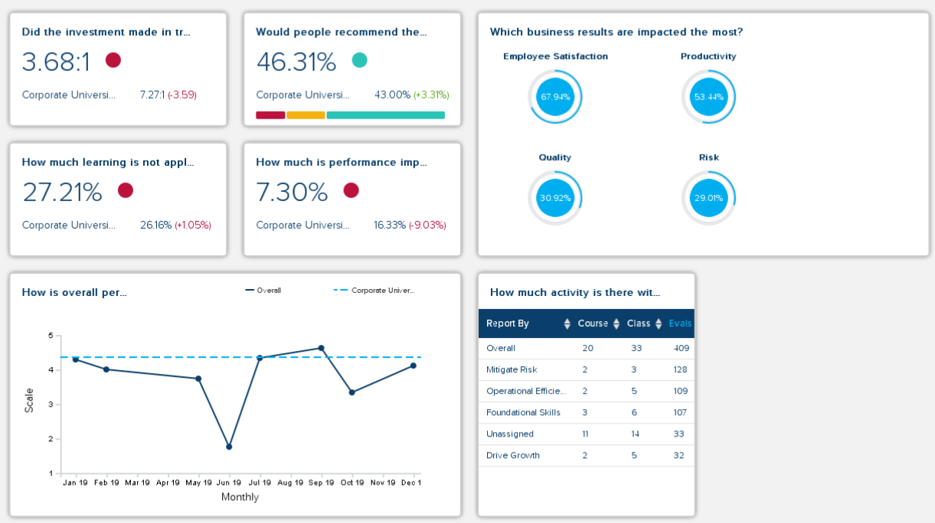
Executive Summary
Option 2: Dashboard (a Dashboard subscription is required for this option)

Slide 8
Executive Summary
Option 3: Text-based summary
Data from this slide mostly comes from the Executive Summary and the Report Card but the strength and opportunity sections may come from other reports (NPS, QQR, etc). The area of opportunity is a call to action to improve or change something, based on what you find while putting the rest of the summary together.
According to learners who responded to the post event survey:
On the Job Application: | Business Impact:
52% of training will be applied on the job This is [in line with, above, or below] the benchmark of X% for [insert the benchmark used] | The business outcomes that will be most impacted by training are: Productivity (68% of respondents) Quality (64% of respondents) Cycle time (60% of respondents)
Successes: | Opportunities:
Instructor quality: 95% indicated that their class instructor was high quality (benchmark is X%) Value: 79% of respondents would recommend the training they took to a colleague (benchmark is X%) | Increase application through manager support: 65% of learners did not discuss a plan with their manager to apply training on the job

Slide 9
Successes
Based on your own data analysis, pick 1-3 successful areas to focus on, and include those relevant slides after this section header.
Examples are provided in this template; however, your presentation should reflect your own data.
Your detailed analysis with Data Explorer or other reports will help you to diagnose drivers of performance.

Slide 10
Opportunities
Based on your own data analysis, pick 1-3 opportunities for improvement to focus on, and include those relevant slides after this section header.
Examples are provided in this template; however, your presentation should reflect your own data.
Make sure that you are prepared to discuss the underlying root cause of any performance gaps. Your detailed analysis with Data Explorer or other reports will help you to diagnose drivers of performance (both good/bad).

Slide 11
The remaining slides are provided as a “bank” of possibilities for presenting different KPIs and should be customized based on your own learning programs’ performance.

Slide 12
Net Promoter
Example of how to present NPS Data.
NPS is a reflection of the learners’ perceived value of training (would they recommend to others).
Tips: look at NPS by Course and Demographic to identify wins or areas of focused improvement.
Reference the Key Metrics Report by Net Promoter Score knowledge article and Key Metrics Report Net Promoter Score Job Aid in the Help Guide for additional guidance in presenting this data.

Slide 13
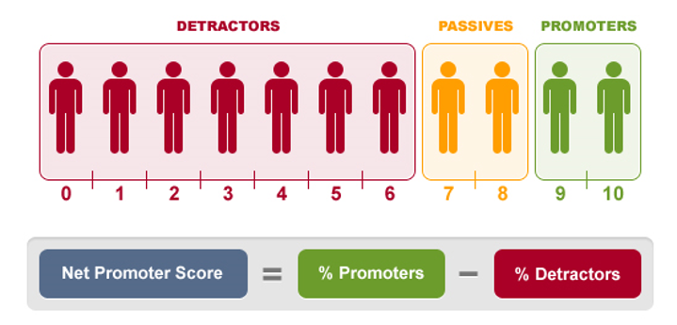
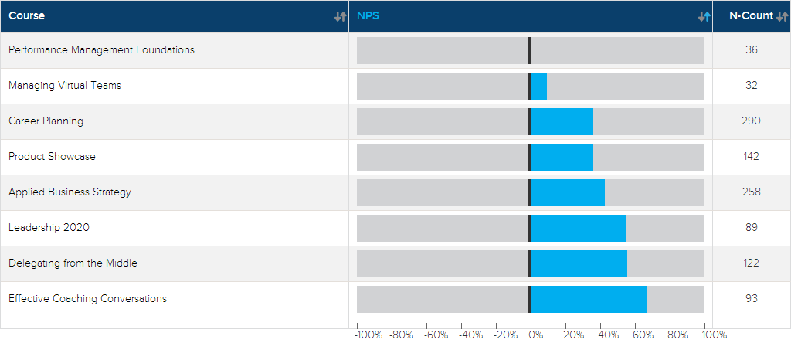
Net Promoter Score
How likely are you to recommend this learning experience?
43% Overall NPS for Q1 vs. Benchmark of 38%
Show NPS by course, and it may be helpful to reference any specific NPS by demographic data that looks interesting in the additional findings.
Notes:
The Net Promoter Score (NPS) allows you to determine how likely learners are to recommend your training, which is an indication of perceived value. We recommend that you determine which courses and/or programs are the most strategic to your organization: which courses should have the highest level of job impact? If you note low Net Promoter Scores with these courses, you should focus your improvement efforts here first. Otherwise, focus your improvement efforts on the courses and/or training elements with the lowest Net Promoter Scores.

Slide 14
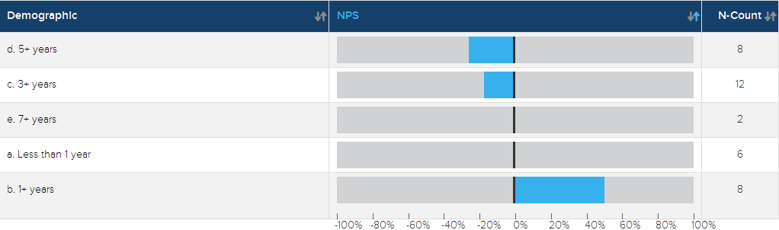
NPS Additional Findings & Recommendations
Provide additional insights and recommendations based on your analysis. Note that these do not all need to be positive or negative.
Performance Management Foundations NPS below benchmark
Demographic analysis for Performance Mgmt Foundations reveals individuals with higher tenure have lower NPS
Indication that wrong audience is sent to this training
Recommendations:
Interview learners from lower-scoring demographic groups to identify the disconnect between the course objectives/content and application
Connect with HR to determine if there’s a way to “shore up” intended audiences by course
Connect with course designers to ensure that appropriate real-world application examples for intended learner audience are included in each training

Slide 15
Impact and Value
Example of presenting Impact and Value, aligned to Portfolio performance.
For additional insights into presenting this information, reference the Key Metrics Report by Performance Improvement Overview knowledge article, the Key Metrics Report by Performance Improvement Job Aid, and the explanation of how PI is calculated in the MTM Help Guide.

Slide 16
Estimated On-the-Job Performance Improvement
46%
45%
58%
8%
65%
Estimated Performance Improvement (PI) Calculation*
Factor | Item | Amount
Estimate | Over time, my job performance in areas related to this content will improve _%. | 46%
Isolate | I would attribute _% of my expected improvement to this learning experience. | 45%
Isolate | The content is applicable to _% of my job. | 58%
Adjust | An adjustment for response bias, confidence, and conservatism. | 8%
*PI calculation is based on Phillips’ ROI Methodology
Notes:
The Estimated Performance Improvement, or PI, calculation, is derived from Phillips' ROI calculation. Essentially, PI is a measure of how much learners' job performance improved as a result of training, adjusted for bias. Performance Improvement represents what percent of a learner's time requires the skills or knowledge learned in the training, multiplied by the percent of overall improvement in that particular area, multiplied by the percent of improvement due to training as opposed to any other factors. We apply a bias adjustment of 65% to the improvement calculation, as research indicates that learners tend to overestimate their ability to apply training on the job, and on average, they overestimate by 35%. The bias adjustment ensures that your PI calculation is more conservative to hedge against overstating the impact of training. Specifically, PI is calculated using standard questions from the MTM SmartSheets, followed by the 65% bias adjustment:
The content is applicable to _% of my job x Over time, my job performance in areas related to this content will improve _% x I would attribute _% of my expected improvement to this learning experience x 65%
PI is a key learning metric that indicates whether or not learners' job performance improved as a direct result of training, speaking to the impact of learning on the business.

Slide 17
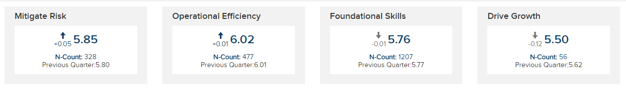
Validating Business Results by Portfolio
Example of presenting Business Results, filtered to each Portfolio to validate whether Portfolio objectives were achieved. Data comes from the Exec Summary Report.
Operational Efficiency
Drive Growth
5 Productivity
72%
5 Productivity
75%
6 Cycle Time
51%
5 Sales
70%
6 Cost
70%
5 Customer Satisfaction
48%
Application
80%
Application
68%
Mitigate Risk
Foundational Skills
5 Safety
80%
5 Productivity
80%
6 Risk
51%
Quality
75%
Quality
70%
Learning Effectiveness
70%
Organization Support
82%
Manager Support
50%
The metrics above represent the % of respondents who responded positively to each scorecard indicator
Notes:
The courses grouped in each of your Portfolios (Operational Efficiency, Drive Growth, Mitigate Risk, and Foundational Skills) are intended to meet specific business objectives and achieve specific business results. Here, your intention is to validate whether or not the courses/programs you deployed in each Portfolio accomplished the intended business results.

Slide 18
Business Results Additional Findings & Recommendations
Pull root cause from Data Explorer analysis
Mitigate Risk courses: Delegating from the Middle, Leadership 2020
Operational Efficiency course: Managing Virtual Teams
Foundational Skills courses: Effective Coaching Conversations
Driving Growth courses: Account Planning Fundamentals, Performance Management Foundations
Recommendations:
Focus improvement efforts on Performance Management Foundations (correct audience, courseware improvements) to improve performance for Driving Growth portfolio
Focusing on improving Support Tools (specifically pre- and post-training manager support) to drive portfolio performance upward for Foundational Skills and maintain/improve performance of Mitigate Risk and Op Efficiency

Slide 19
Job Application
Example of presenting Job Application (scrap) data.
Additional resources include the Key Metrics Report by Scrap Learning Overview and the Key Metrics Report by Scrap Learning Job Aid.

Slide 20
Reduce Scrap, Increase Performance
Post Event (Predicted): I will use _% of this content on the job.
Follow-up (Reported): I have used _% of the content on the job.
Slide provides context around the scrap learning metric
= Learning Organization > 300 organizations > 18 million evaluations
40%
As Scrap decreases, Estimated Performance Improvement due to training increases, providing more benefit to the organization.
Performance Gain Due to Learning
20%
0%
60%
30%
0%
Scrap Learning Rate
Source: CEB analysis.

Slide 21
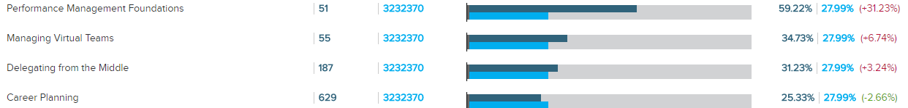
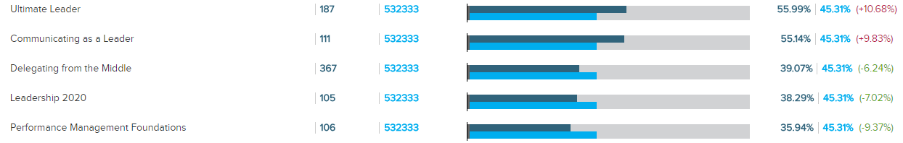
Higher Scrap = Less Job Application
Data comes from the:
Key Metrics Report and Scrap Learning Output
Post Event
Follow-up

Slide 22
Reduce Scrap to Increase Application
Key Drivers and recommendations come from your Instant Insights Dashboard
Key Drivers* of Scrap:
Courseware: “The content was relevant to my job.”
Support Tools: “The participant materials (manual, presentation handouts, job aids, etc.) will be useful on the job.”
Recommendations:
Interview learners from lower-scoring demographic groups to identify the disconnect between the course objectives/content and application
Connect with HR to determine if there’s a way to “shore up” intended audiences by course
Connect with course designers to ensure that appropriate real-world application examples for intended learner audience are included in each training
Have Instructional Designers examine low-scoring courses to determine where revisions or additions can be made to support materials
*The greatest strengths, calculated in MTM, relative to our scrap learning percentage; the areas to focus on first to reduce scrap

Slide 23
On-the-Job Support
Example of presenting Support Tools data

Slide 24
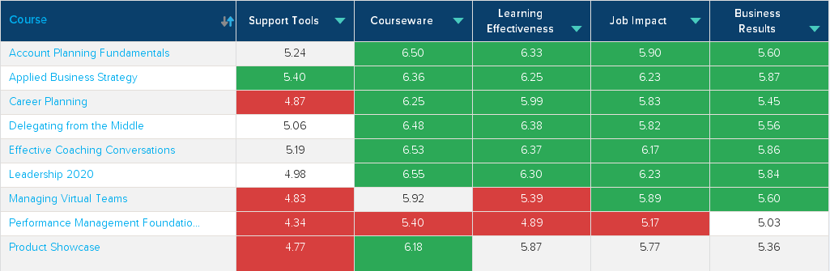
Support Tools Impact: On-the-Job Application
Pre- and post-training support is a primary driver of on-the-job application of learning
Ensuring that learners and managers discuss learning expectations both before and after learning can increase learner performance up to 20%
Lack of support is a primary driver of scrap
Data comes from the Report Card and Data Explorer (Compare)

Slide 25
Student and Manager Pre- and Post-Training Support: The Classic Disconnect
Data comes from the Report Card
Support Learners Receive:
My manager and I have discussed how I can apply what I learned. (3.68) (Benchmark: 4.61)
My manager and I discussed my goals for attending this learning experience. (5.20) (Benchmark: 5.83)
Support Managers Provide:
My employee and I have discussed how they can apply what was learned. (3.78) (Benchmark: 5.18)
Prior to their attendance, my employee and I discussed the reasons for participating in this learning experience. (6.05) (Benchmark: 5.61)
Recommendations:
Hold an education session for managers to articulate the expectations and best practices for them to support the application of learning program
Provide managers with templates or job aids they can use to hold expectation-setting and follow-up conversations with their employees
Direct learners to email their action plans to their managers at the conclusion of each class
Have Instructional Designers examine low-scoring courses to determine where revisions or additions can be made to support materials

Slide 26
Content
Example of presenting Courseware/Content performance

Slide 27
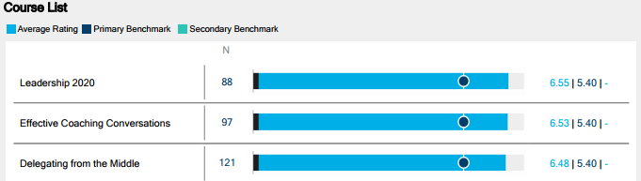
Content Successes
Pull Learner Comments from Data Explorer or the Learner Comments – Learner Sentiment Variance Report
Courseware stats are from Report Card
Top 3 Courses
“The real-world examples provided practical application of the training.”
“Great content – I learned a lot of new information in this class.”
Course Performance from Data Explorer, filtered to the Courseware Question Category
“I thought the examples were great, they related to some of the examples I’ve encountered on the job.”

Slide 28
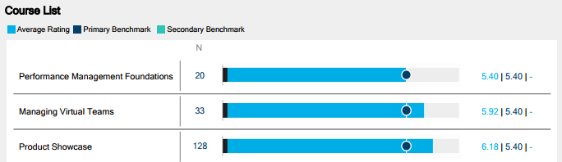
Content Opportunities
Pull Learner Comments from Data Explorer or the Learner Comments – Learner Sentiment Variance Report
Courseware stats come from Report Card
Bottom 3 Courses
“I was familiar with all the content presented – I didn’t learn anything new.”
“Too basic for my level – please have a part II of this class.”
Course Performance from Data Explorer, filtered to Courseware Question Category
Recommendations:
Correct audience for these courses by updating course descriptions in our catalog to include intended audience/level
Revise courseware to provide more on-the-job application activities and examples
Ensure Instructors are trained on how to discuss job application and relevance
Ensure managers discuss training expectations both before and after training
“Show us some examples within our company.”

Slide 29
Training Delivery
Example of presenting training delivery results

Slide 30
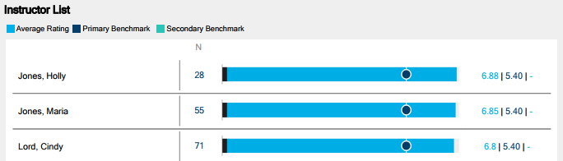
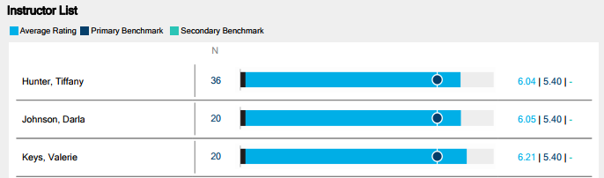
Training Delivery Highlights
Overall Instructor Performance, compared to benchmark
Top 3 Instructors
Bottom 3 Instructors
Data comes from the Report Card and Data Explorer. Data Explorer (Top 3/Bottom 3)is filtered to the Instructor Question Category
Recommendations:
Maintain current Instructor development programs to ensure performance remains at/above benchmark for all instructors
Stretch goal: Work with Instructors to ensure they understand how they influence other learning KPIs and can impact on-the-job application of learning

Slide 31
Strategic Recommendations

Slide 32
Strategic Recommendations
Recommendation 1:
Recommendation 2:
Recommendation 3:
Recommended next steps to take with the data.
Use the “What, So What, Now What” framework, and if there are a couple of meaty recommendations, feel free to lay them out 1 per slide, across multiple slides.

Slide 33
Next Steps

Slide 35
Appendix

Slide 36
MTM Measurement Methodology
A summary of the data contained in this report:
Date range:
# Classes:
# Courses:
# Surveys:
Benchmark comparison:
Notes:
This slide provides some orientation to the data set we will be reviewing in today’s data summary.

Slide 37
MTM Standard Survey KPIs
MTM’s suite of standard surveys contain a balanced set of KPIs to:
Run L&D like a business
Articulate L&D’s contribution to business objectives
Align and partner with the business
L&D Focus
Business Focus
Internal “Run L&D” KPIs
Align/Partner with the Business KPIs
Instructor | Application | Manager Support
Content | Scrap Learning | Organizational Support
Learning Environment | Net Promoter | Performance Improvement
Knowledge Gain | Criticality | Business Results
Support Materials | Alignment | ROI
Notes:
And in case you are not familiar, this slide contains our key KPIs, many of which you will see highlighted in today’s presentation.

