Slide 1
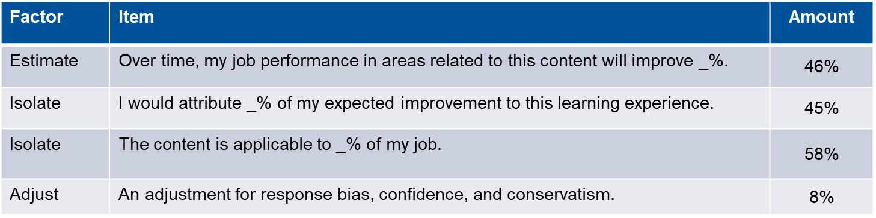
Estimated On-the-Job Performance Improvement
46%
45%
58%
65%
18%
1

Slide 2
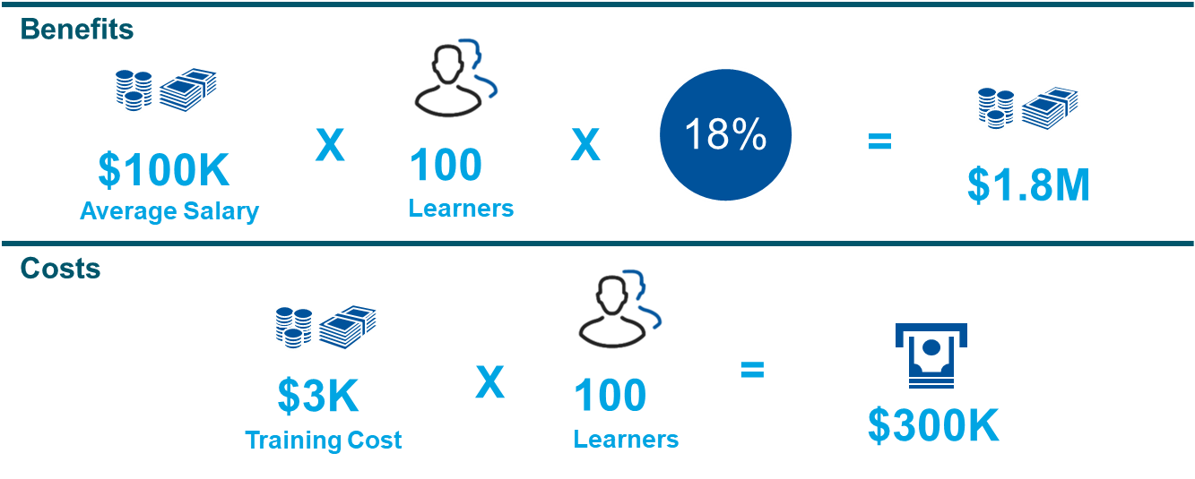
ROI Indicator Using Salary and Costs

Slide 3
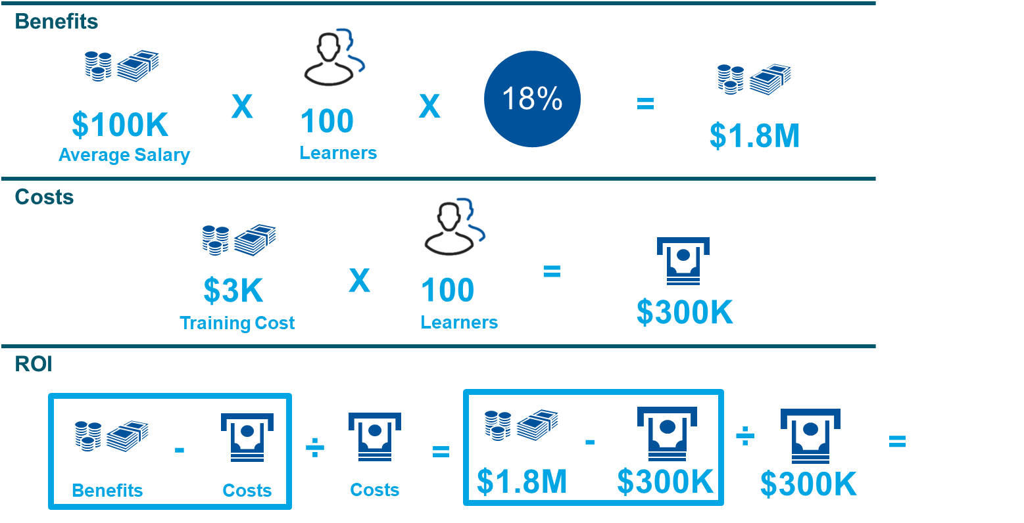

ROI Indicator Using Salary and Costs
5.0
5.0

Slide 4
Let’s Break it Down

Slide 5


Company Assets
Company Buys a Laptop
Company Hires a Person
Cost was $3,000
Expectation is that the company will get $3,000 of value out of that laptop
How?
  It may help a salesperson increase sales
  Help a plant floor operator increase quality
  Ultimately the goal is to improve a user’s job performance through the technology
Recap: The expectation is that at least $3,000 will be of benefit in exchange for paying the cost of $3,000 to acquire the laptop
Cost was $100,000 (full loaded salary – wages, benefits, overtime)
Expectation is that the company will get $100,000 of value out of that individual
How?
  Could come from their contributions in one or more key business objectives such as sales, quality, productivity, cycle time, customer satisfaction, etc…
Recap: The expectation is that at least $100,000 will be of benefit in exchange for paying the cost of $100,000 for the employee.

Slide 6

Time to Upgrade!
Company Upgrades Laptop
Company Upgrades a Person
Cost of the Upgrade is $500
Why is the IT department upgrading the laptop?
  Intended to make the machine faster, more resistant to bugs, more accurate in processing computations
How will this help the company?
  The business result is more productive employees, higher quality and reduced cycle-time for a user of the laptop.
Recap: The expectation is that the $500 spent on the upgrade will result in at least $500 returned in various benefits.
Cost of the training is $3,000
Why is the organization training the person?
  Training is a tool to upgrade people just like we add components to a laptop to upgrade our technology.
How will this help the company?
  The goal is that the employee will leverage the training to help achieve various business results back on the job. Such results include increased sales, quality, customer satisfaction, productivity, etc…
Recap: The expectation is that at least $3,000 spent on the training will result in at least $3,000 returned in various benefits.

Slide 7
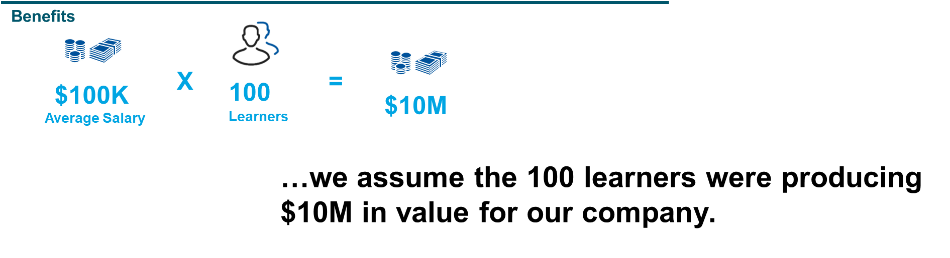
So Before Training…

Slide 8
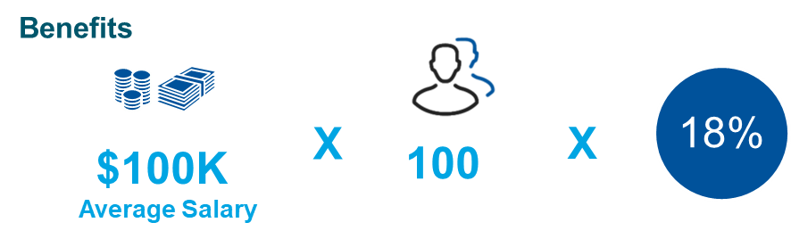
But then they went to training and got 18% better at their job!
…we know they got 18% better because we asked them after the training:
To Estimate how much their job performance would (did) improve
To Isolate how much of that will be (was) related to this learning experience
And to further Isolate how applicable the content is (was) to their job
And then we multiplied all that by 65% to get a conservative estimate of performance improvement.
Estimation is a common practice in business today and this is an industry accepted approach.

Slide 9

And we can monetize that
Benefits
18%
X
X
=
$100K
100
$1.8M
Average Salary
Learners
If we expected a value of $10 million before but now their performance has improved by 18% then now the value of the group is $11.8 million.
This is a monetized benefit of $1.8 million.

Slide 10
But the training DID cost us something!
Benefits
18%
X
X
=
$100K
100
$1.8M
Average Salary
Learners
Costs
X
=
$3K
100
$300K
Training Cost
Learners
…we then compared this to the full cost of the training.

Slide 11
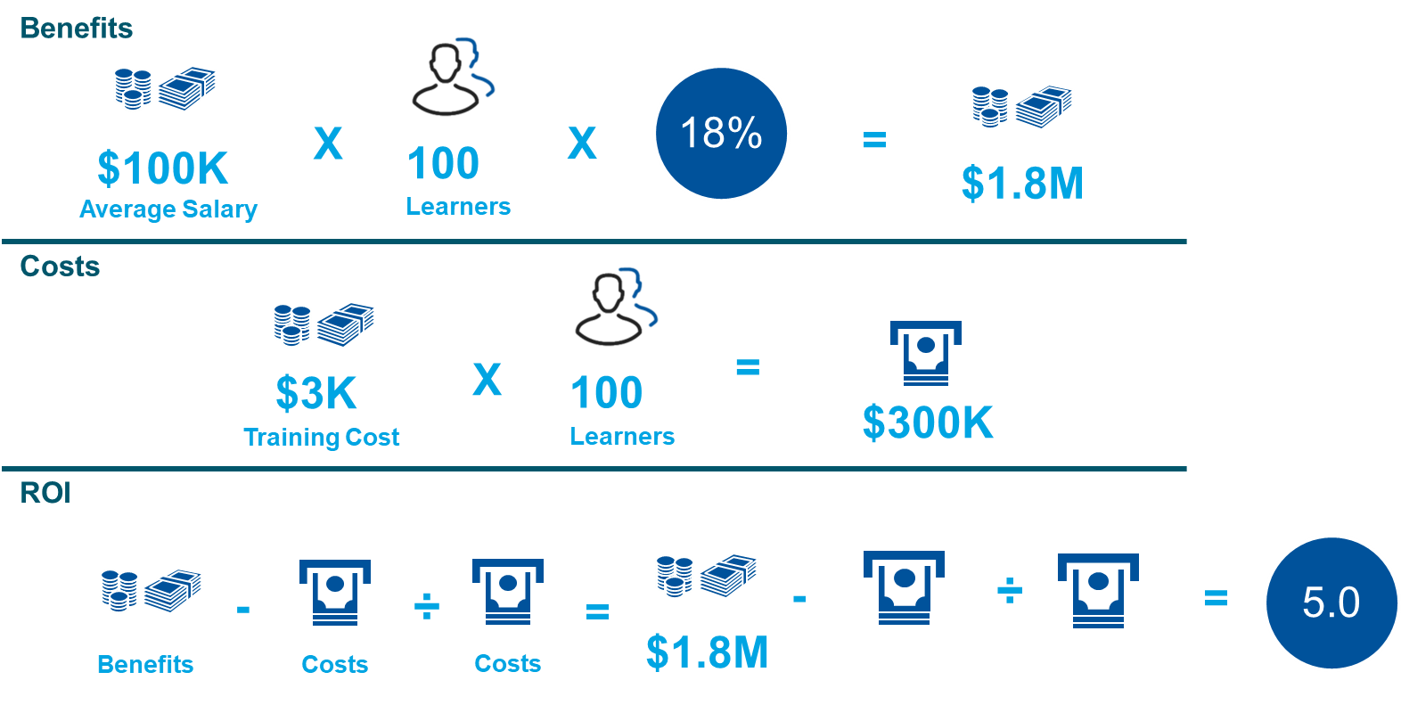
And When We Make this Comparison of Monetized Benefit to Cost, We Can See the Strength of the Return on our Training Investment

Slide 12
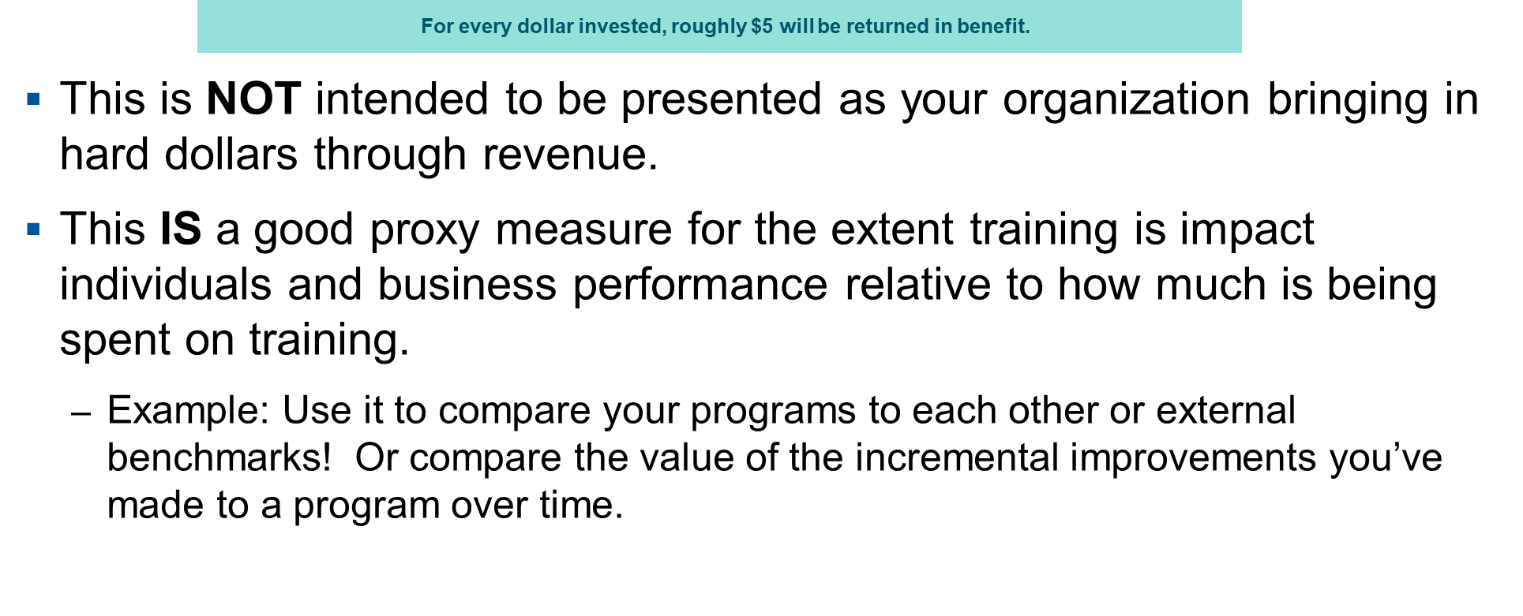
So what does that mean?

Slide 13
Benefits & When to Use

Slide 14
Benefits to this Approach
Cost effective
Resource efficient
Scalable and replicable
Benchmarkable both internally and externally
Uses reasonable assumptions based on industry proven pricinples and methodologies
Provides valuable business intelligence to a variety of stakeholders

Slide 15
When to Use
This approach does require a more detailed data collection / analytics exercise and so typically it is used in your Drive Growth, Operational Efficiency, and Foundational Skills portfolio of learning assets.
Benefits here are based on assumptions and derived by linking to the known monetary value that is place on human capital: an employee’s fully loaded salary.
For your most strategic, visible, and costly programs an impact study which focuses on actual business results data to connect learning to business outcomes may be required.

